Slide 1
What are projection-based ROMs?
Projection-based ROMs (pROMs) are data-informed methods
Operate by projecting governing equations onto low-dimensional subspaces
pROMs use basis functions constructed from data
Involves solving the governing equations
Other types of ROMs:
Data-centric surrogate models: create a purely data-driven surrogate model
Reduced fidelity/physics models: use coarse meshes and/or reduced physics

Slide 2
Pressio
A computational framework aimed at providing performant pROMs to generic application codes
Open source code developed at Sandia:
Lead developer: Francesco Rizzi
Team: Patrick Blonigan, Eric Parish, Kenny Chowdhary, John Tencer, …
Former developers: Kevin Carlberg and Mark Hoemmen
Main idea:
Separate the “application” from the ROM
ROM methods are contained in the Pressio framework
Pressio “plugs in” to an application code
rom
https://github.com/Pressio

Slide 3
High-level features
Header-only C++11 library
Benefits portability
Leverages C++11 and metaprogramming for type detection and compile-time dispatching
Supports HPC programming models (e.g., Kokkos, tPetra)
Support for GPU computing via Kokkos
Supports a Python API
Enables Python users to use the C++ Pressio functionalities from Python
Supports Galerkin, LSPG, and WLS ROMs (w/ hyperreduction)

Slide 4
How does Pressio talk to an application?
Pressio’s API requires the application to expose two main functions:
velocity:
applyJacobian:
rom
Pressio uses these functions to construct the ROMs
For hyper-reduction, we require velocity and applyJacobian to return results at only a subset of the mesh

Slide 5
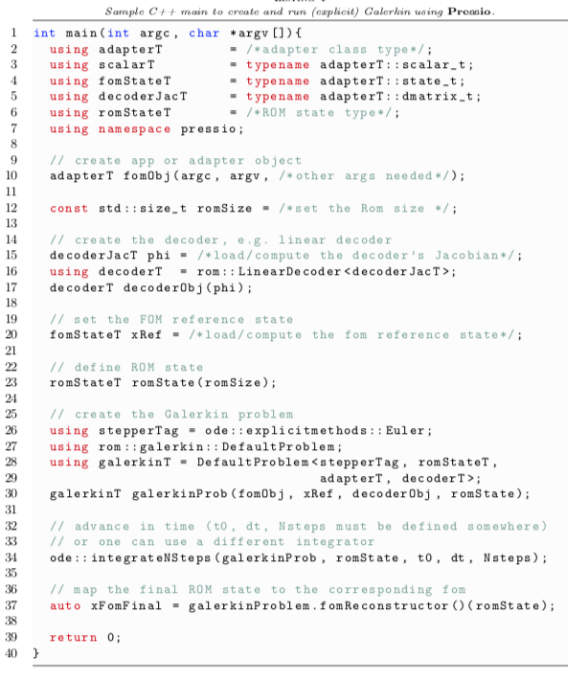
Pressio: How do we build and run a ROM?
Create the FOM object
Load/compute the POD modes
Create the ROM problem
Advance in time

